Slide 1
Friday Calendar
Sprint 4

Slide 2
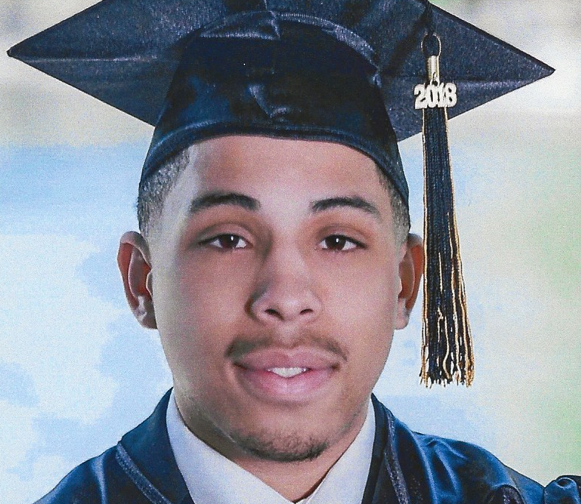
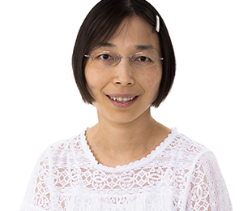
Meet the Capstone Team
Cameron Slash
caslash@bsu.edu
Michael Heckman
msheckman@bsu.edu
Lloyd Rowe
lnrowe@bsu.edu
Dr. Lan Lin
Capstone Professor
llin4@bsu.edu

Slide 3
Meet the Client
QuantumRhino - Scottsdale, Arizona (remote-based company)
A Veteran owned, US-based, business-first technology solutions and software integrations consulting company
QuantumRhino.com
Client Team
Chris Sinkwitz – CEO, Overall project contact and manager
Drew Thomsen – Company Technology Specialist
Dan Jarvis – Software architect
Ivan Lopez – Software Developer

Slide 4
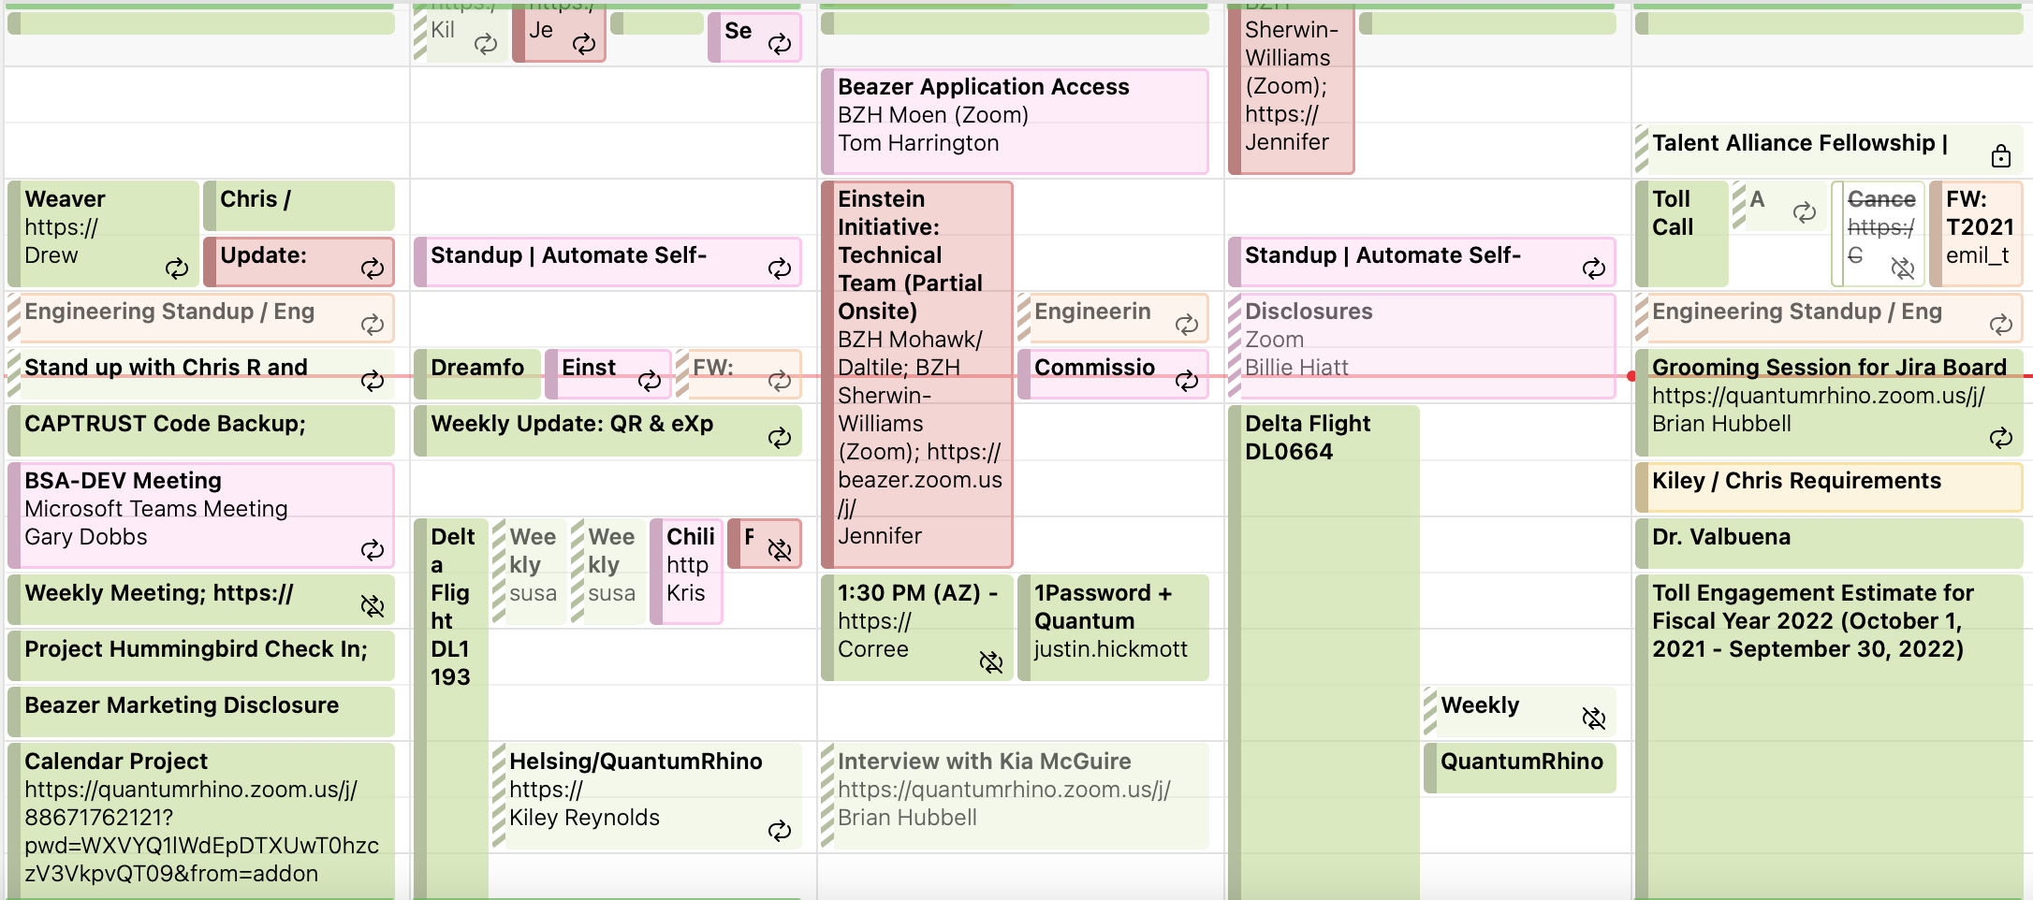
The Problem
QR employees use multiple calendars daily, often one per client. Scheduling meetings with the development team is impossible often requiring the scheduler to look at multiple calendars for each person on the development team, leading to over booking.
A real life example of the CEO's calendar
Notes:
As a business owner, as the business grows, it has become increasingly harder to schedule meetings both internally with my team as well as provide accurate availability externally to other busy executives, through several different calendars

Slide 5
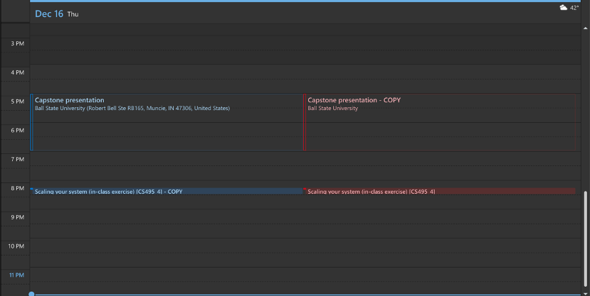
The Solution
Allow the user to add multiple calendars, either Google or Microsoft, and then as events are added sync them across all the calendars
A screenshot showing a copied event
Notes:
As a business owner, as the business grows, it has become increasingly harder to schedule meetings both internally with my team as well as provide accurate availability externally to other busy executives, through several different calendars

Slide 6
The Deliverable
A web app that will accept multiple Google and Microsoft accounts and then multiple specific Calendars for each account
A behind the scenes integration that will sync events from one calendar to all the other calendars that were added
This will allow users to continue using their preferred calendar app without navigating across several accounts to schedule meetings or look at their day
Notes:
As a business owner, as the business grows, it has become increasingly harder to schedule meetings both internally with my team as well as provide accurate availability externally to other busy executives, through several different calendars

Slide 7
The Tech Stack
AWS
DynamoDB, Lambda functions, backend testing
NextJS
A react framework used to create the app
Vercel
Web Hosting
GitHub
Issue tracking, development, project management
Notes:
As a business owner, as the business grows, it has become increasingly harder to schedule meetings both internally with my team as well as provide accurate availability externally to other busy executives, through several different calendars

Slide 8
Home Page

Slide 9
Logging in
The user then selects Google or Microsoft

Slide 10
After Logging In
User's profile picture is now visible next to sign out button

Slide 11
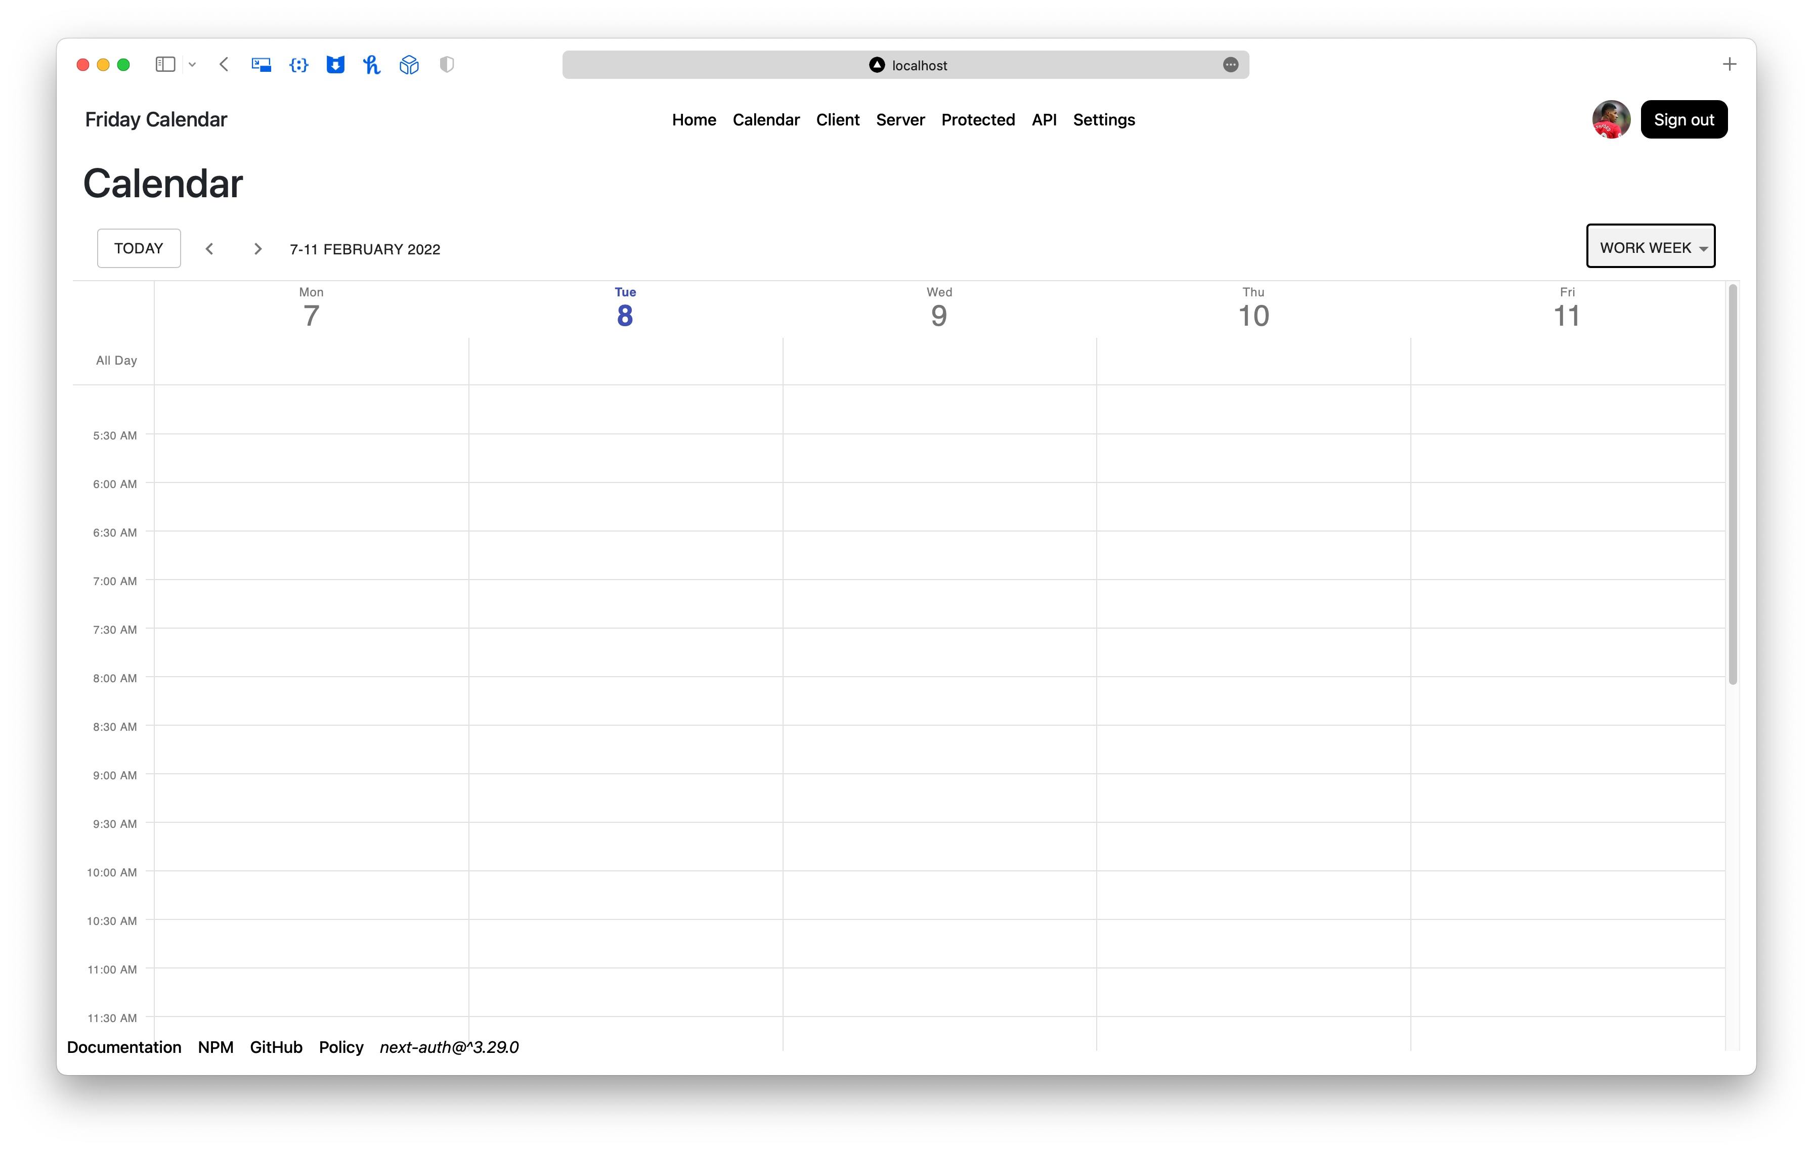
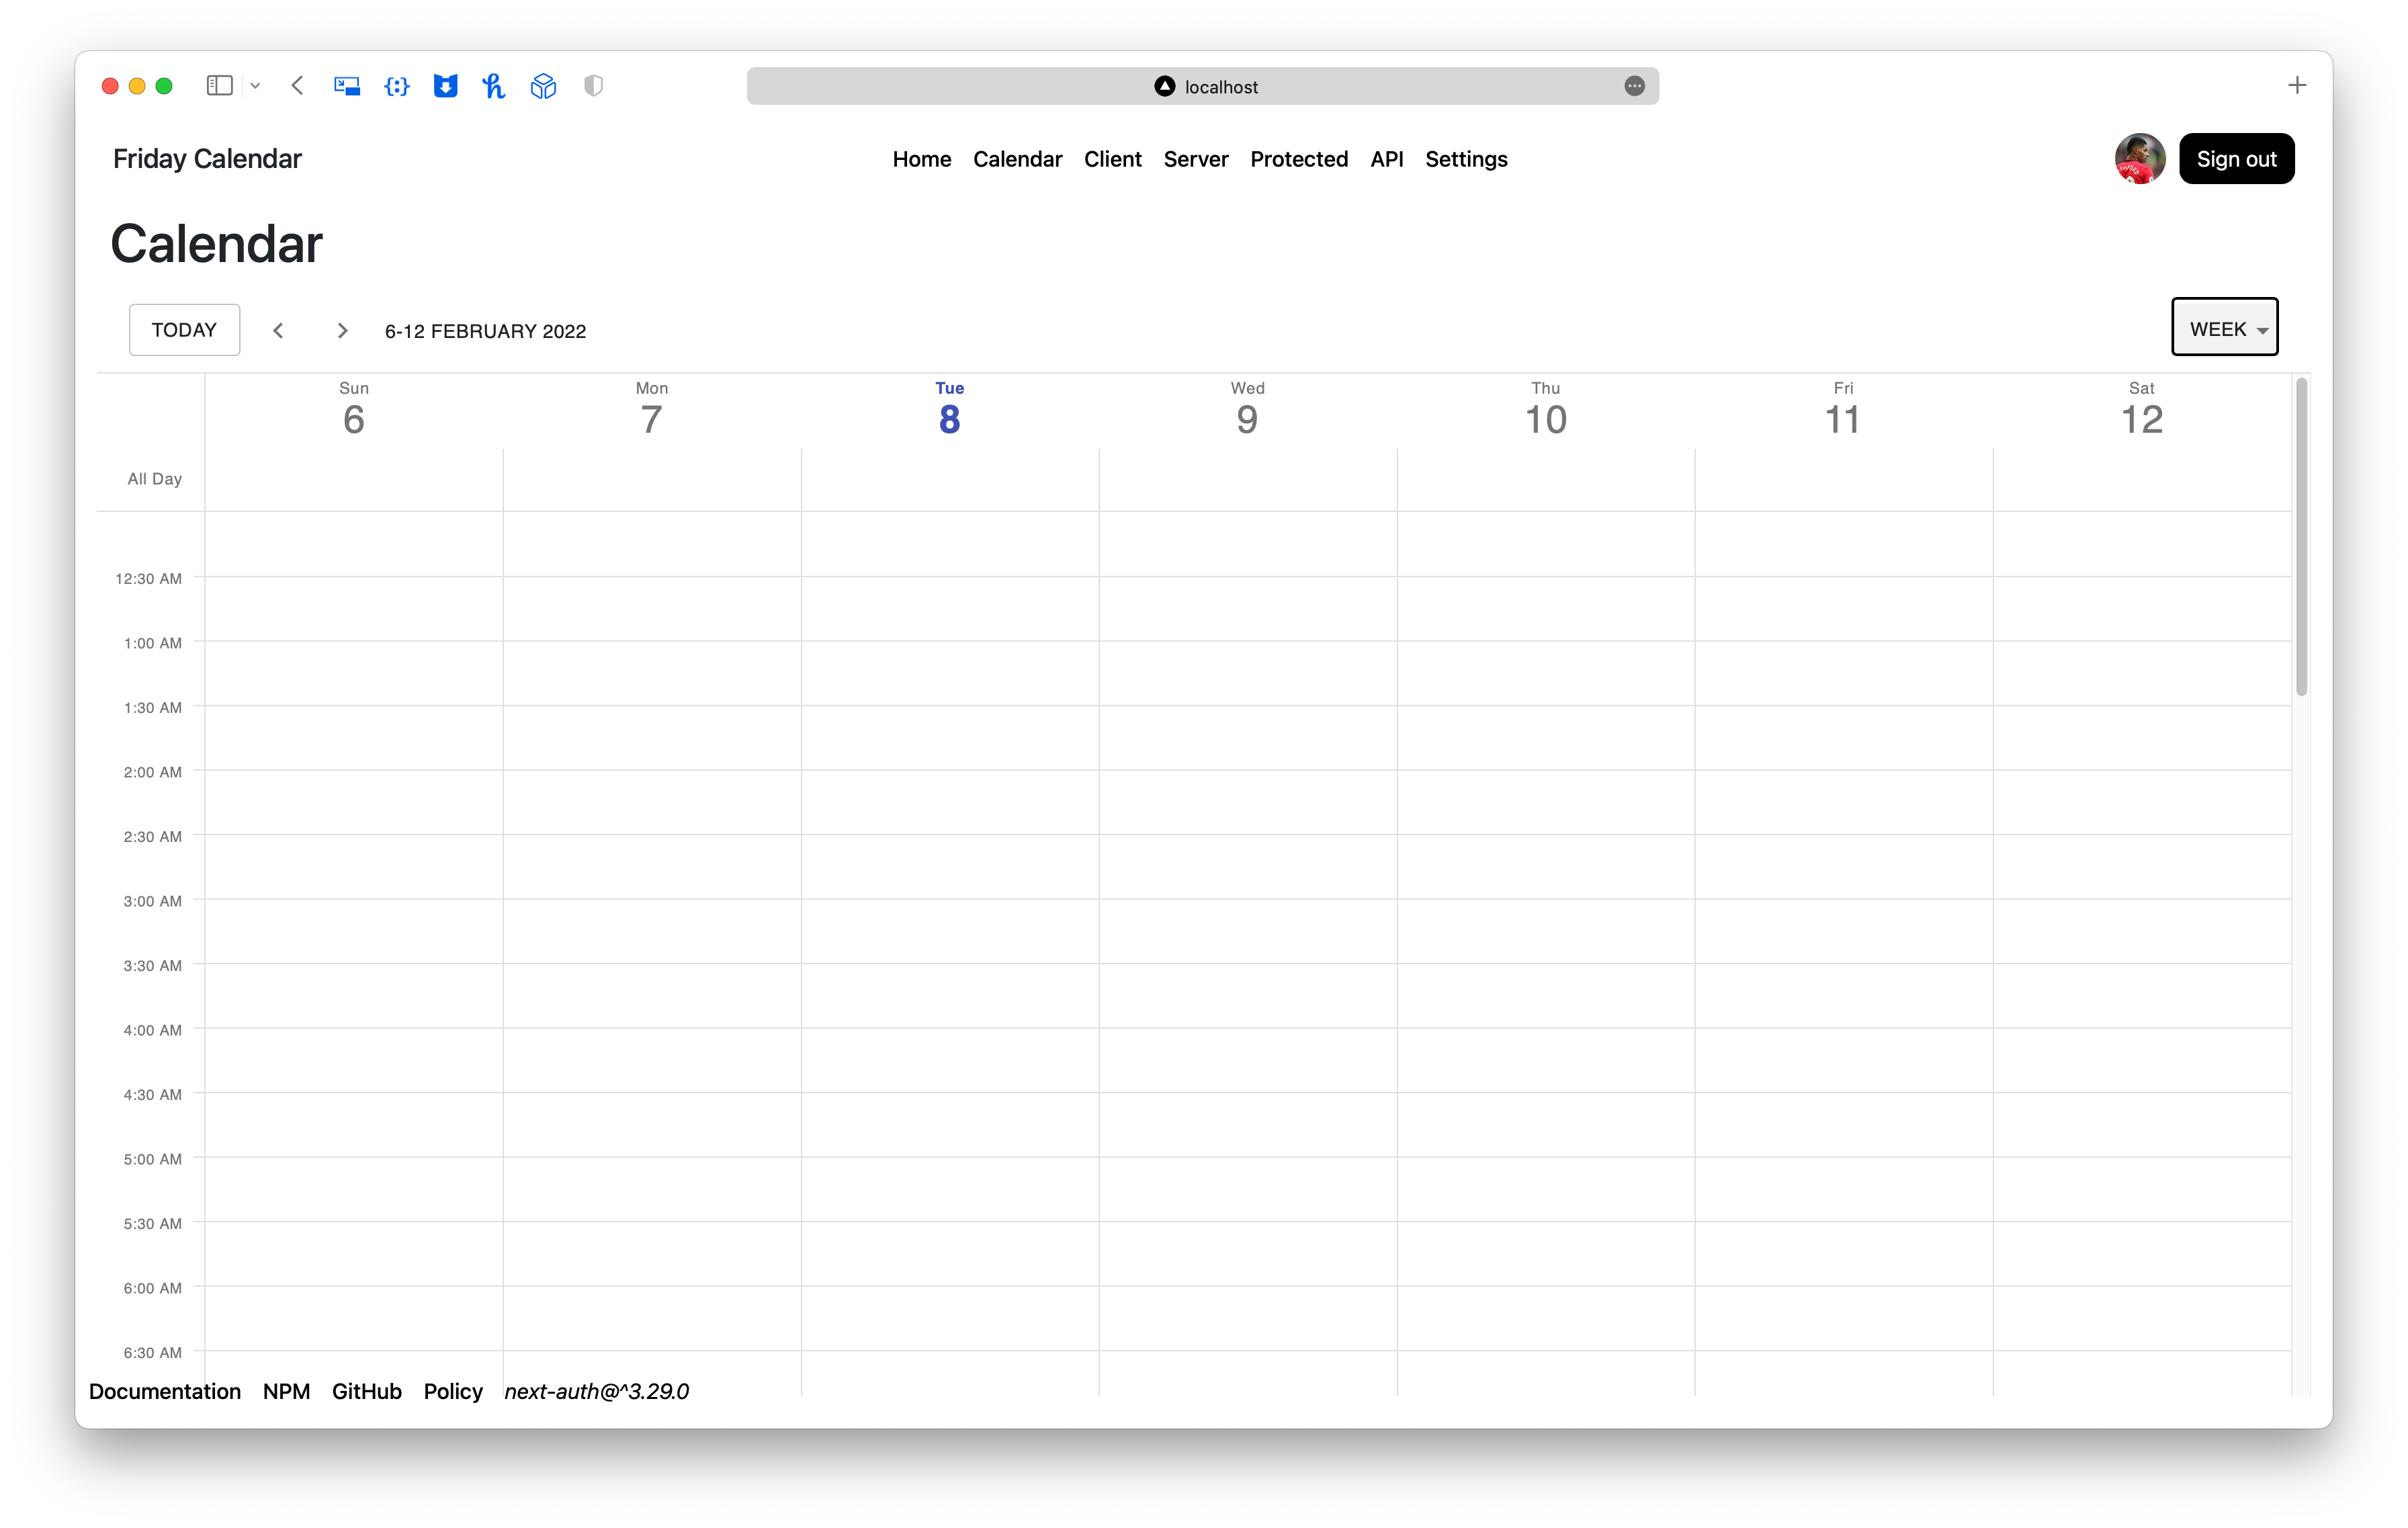
Calendar UI
Work week calendar view
Week calendar view
Day calendar view

Slide 12
Calendar UI
Example of events in the calendar

Slide 13
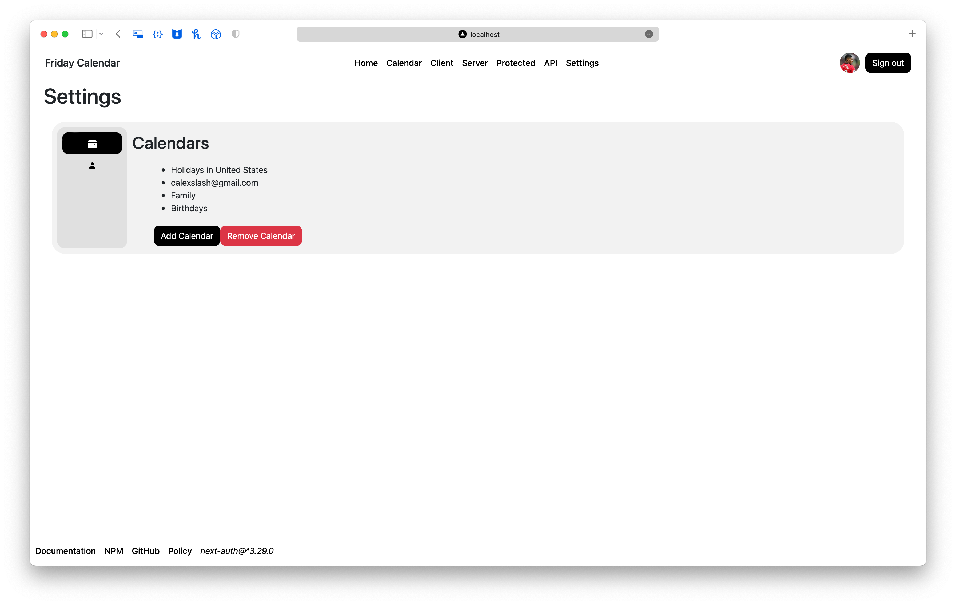
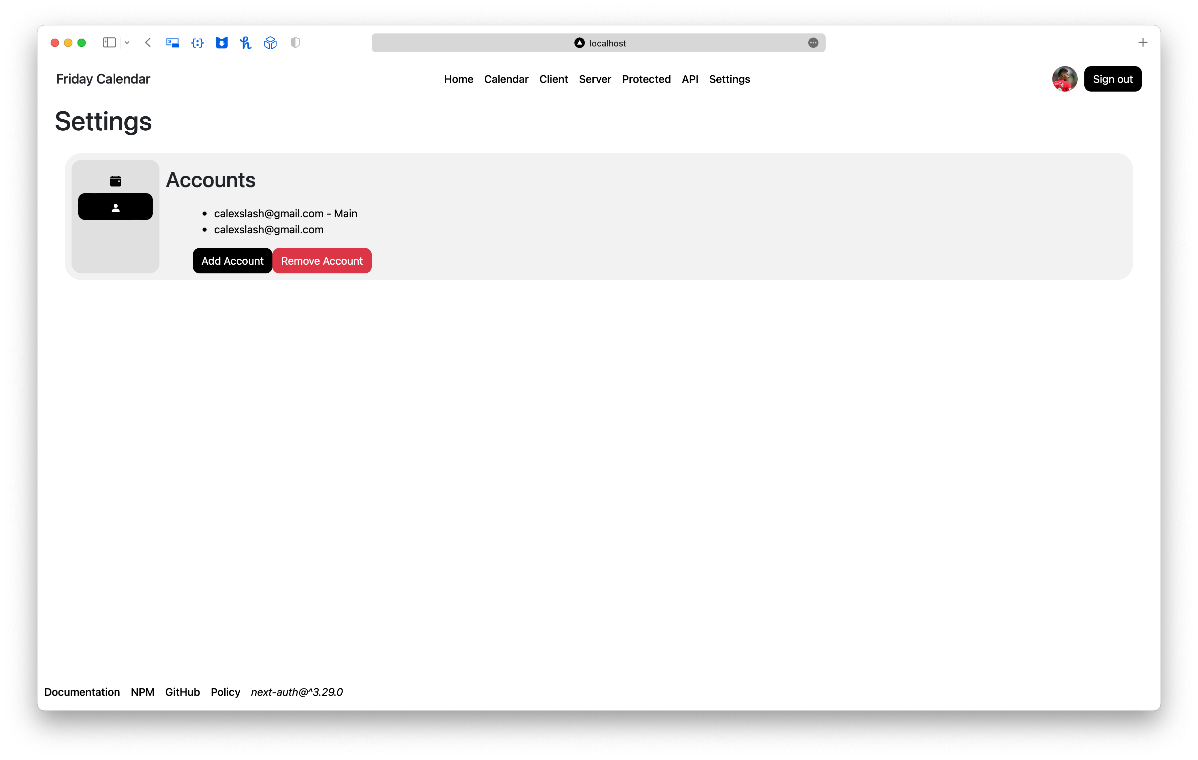
Settings Page
Calendar settings for adding/removing calendars
Account settings for adding/removing accounts

Slide 14
Demo

